Slide 1





“Aims to treat and prevent anxiety, increase emotional resilience and problem-solving abilities, and teach lifelong coping skills to young people to protect them against stress and change in later life” (Barrett, 2010).

Slide 2
Who is it for?
Treatment programmes
Selective programmes
Universal programmes
After Onset
of Disorder
Prior to Onset
of Disorder

Slide 3
What is ‘FRIENDS’?
10 week long, manualised, school based programme
1-2 hours each week
Range of activities
Process and structure important
Shared understanding – home and school
Recommended by the World Health Organization (2004)

Slide 4

“FRIENDS?”
Our body is our friend
Working together and making friends
Our
Develop skills needed to talk to our friends
Acronym for the skills taught

Slide 5
Programme Structure
Acronym |  | Objective | Session
F | Feelings | Recognising and labelling feelings, linking them to body cues. | 1,2,3
R | Remember to Relax | Way of managing difficult feelings. | 3
I | I can do it! I can try my best! | Understanding negative and positive self-talk and learning to think in positive ways. | 4,5
E | Explore Solutions and Coping Step Plans | Strategies for managing difficult situations. | 6,7,8
N | Now Reward Yourself! You’ve Done Your Best! | Highlighting the importance of rewarding yourself for trying. | 9,10
D | Don’t Forget to Practise | Practising the strategies will help them become more automatic. | 9,10
S | Smile! Stay Calm for Life | Congratulations for participation and hard work. | 9,10

Slide 6
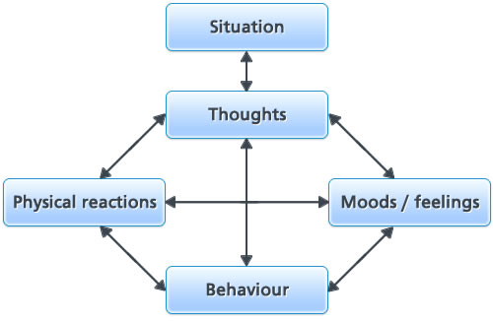
Underpinning theory: CBT
https://alexisstone55.files.wordpress.com/2012/11/cbt-diagram.jpg

Slide 7

Milkshake breathing
R | Remember to Relax

Slide 8
I | I can do it! I can try my best!
I’m going to make a fool of myself
It doesn’t matter what anyone thinks
Are you sure this is really going to happen?
Does it always happen?
Tell me when it didn’t happen.
How much does it matter what other people think?
Are you forgetting the positives?
Can you really expect to be perfect at everything you do?
I can’t do it!
I can try my best!
What if I make a mistake?
I’m going to give this a shot

Slide 9

Unhelpful
thoughts
Feelings
Reactive
Behaviours
Situation
Challenger Questions
Helpful
thoughts
Feelings
Proactive
Behaviours

Slide 10
I’ve prepared well and know this presentation. I can do this!
E | Explore Solutions and Coping Step Plans
Present in front of the whole class
My friend will support me, give me feedback and think I am brave
Present to a small group of friends
Present to one close friend
This is ok, no one is watching
Present the speech to the whole family
Read to mum or dad
Read in front of the mirror

Slide 11
FRIENDS
“Unique in its commitment to evidence-based research support for all aspects of the programme”
(Pathways, 2012)

Slide 12
Underpinning theory
CBT approaches are effective as both a prevention and treatment of childhood anxiety (Fisak, Richard, & Mann, 2011; Neil & Christensen, 2009)
FRIENDS dominates reviews
Underlying principles
Theoretical concepts which it aims to change e.g. coping skills

Slide 13
Research
Barrett and Turner (2001)
Significant post-intervention reductions in anxiety
Lowry- Webster, Barrett & Dadds (2001)
Intervention group reported fewer anxiety symptoms, regardless of their risk status, than the comparison group at post- test.
Lowry- Webster, Barrett & Lock (2003)
Maintained at 12 month follow up as measured by self-reports and diagnostic interviews.
Lock & Barrett (2003)
Primary school children reported greatest changes in anxiety symptoms
Barrett, Farell, Ollendick & Dadds (2006)
Reductions in anxiety reported in Lock and Barrett were maintained for primary students.
Prevention?

Slide 14
UK Studies
Stallard, Simpson, Anderson, Hibbert & Osborn (2007)
Significant reduction in anxiety 3 months following intervention
Stallard, Simpson, Anderson & Goddard (2008)
12 month follow up – reduced anxiety maintained for both whole group and high risk group
Preventative effects
Liddle and Macmillan (2010)
Randomisation at individual level, implemented by EPs
Reduction in anxiety which was maintained at four month follow up

Slide 15
Systematic reviews
Briesch, Hagermoser Sanetti, and Briesch (2010)
“research to date suggests that FRIENDS may be a promising intervention for the treatment of anxiety in school based settings” p.163.
Maggin and Johnson (2014)
“the research underlying school-based versions of the FRIENDS program presently lacks the rigor to certify it as an evidence-based practice”
Notes:
Unit of random assisnment vs unit of analysos

Slide 16
Conclusions
Positive effects across individual studies, but methodological concerns
Limited UK based and independent research
Implementer?
Useful activities for whole-school implementation
Implications for EPs
“In order to help their pupils succeed, schools have a role to play in supporting them to be resilient and mentally healthy,’ (DfE, 2014, p4).

Slide 17

Big thank you to Hampshire Educational Psychology for access to training resources and pathways subscription

